Slide 1
Data Dissemination and Management (3)

Slide 2
Data Dissemination and Management - Topics
Mobile Data Caching
Mobile Cache Maintenance Schemes
Mobile Web Caching
Summary

Slide 3
Mobile Data Caching
Memory Hierarchy
  Processor (CPU) Registers
  Cache
  Main memory (RAM/ROM)
  Mass storages: disks, tapes
Cache
  Small, Fast memory for holding frequently used data
  Improvements
    Improving Data Access Latencies
    Improving Data Availability

Slide 4
Mobile Data Caching
Cache management schemes
  Predict/estimate which data items are most likely to be used in the future
  Copy them to the cache memory (closer to the processor)
  Cache miss and cache hit
  LRU (Least-Recently Used) and Prefetching algorithms

Slide 5
Mobile Data Caching
Caching in Traditional Distributed Systems
Distributed Systems and Network Computing Environments
Scenario 1
  Data in the shared memory or servers
  Data can be read or written by different clients concurrently (Distributed File System)
Scenario 2
  Data in the shared memory or servers
  Data are read-only for the clients (WWW)
Data may be replicated onto multiple servers: improve fault tolerance and availability
A client just modified the data item before another client access it

Slide 6
Mobile Data Caching
Caching in Traditional Distributed Systems
Distributed Systems and Network Computing Environments
Most Crucial Problem for caching
  How to maintain data consistency among the clients and servers
  Complexity arises from the various failures
    Server Failure
    Network Failure
    Client Failure
Approaches used to maintain data consistency
    Polling every time
    Adaptive time to live (TTL)
    Leases-based invalidation

Slide 7
Mobile Data Caching
Cache Consistency Maintenance
Purpose of caching:
  Improve data access performance
  Improve data availability
    Trade-off : data consistency
Data Currency Requirement
Cache Consistency Maintenance Schemes depends on applications
  WWW
  Distributed File Systems
  Client-Server Databases

Slide 8
Mobile Data Caching
Cache Consistency Maintenance
Cache Consistency Models
  Classic Techniques
    Call backs and Validity Checks
    Designed for distributed computing environment connected via reliable wired links
    Not suitable for Mobile client (lost connection, etc)
    Refetching valid data – wasting bandwidth
  Strong Cache Consistency Model:
    Data x(t) is the most recent x(t)? Checked with the server before access
    Mobile computing environment – make it unusable when disconnections become frequent

Slide 9
Mobile Data Caching
Performance and Architectural Issues
Various issues and Considerations for Designing Mobile Caching Strategies
  Data access pattern
  Data update rate
  Communication/access cost
  Mobility pattern of the client
  Connectivity characteristics (disconnection frequency, available bandwidth)
  Data currency requirements of the User (user expectations)
  Context dependence of the information

Slide 10
Mobile Data Caching
Performance and Architectural Issues
Need to address the following problems
  How to reduce client-side latency
  How to maintain cache consistency between various cache and the servers
Being studied extensively in distributed systems and wired networking environments
Not new to mobile computing environments

Slide 11
Mobile Data Caching
Performance and Architectural Issues
Need to address the following problems
  How to ensure high data availability in the presence of frequent disconnections
  How to achieve high energy/bandwidth efficiency
  How to determine the cost of a cache miss and how to incorporate this cost in the cache management scheme
  How to manage location-dependent data in the cache
These 4-problems are new to the mobile computing environment

Slide 12
Mobile Data Caching
Performance and Architectural Issues
Need to address the following problems
  How to enable cooperation between multiple peer caches
Need to consider
  Peer-to-Peer paradigm
  Ad Hoc Networks

Slide 13
Mobile Data Caching
Performance and Architectural Issues
Cache Organization Issues
  Where do we cache?
    Server? Proxy? Client?
    Frequency, Pattern, Cost of access
    At server: aggregated access pattern, retrieving cost
    At proxy and client: access pattern, communication cost, update rate
  How many levels of caching do we use (hierarchical caching)?
  What do we cache (when to cache a data item and for how long)?
  How do we invalidate cached items?

Slide 14
Mobile Data Caching
Performance and Architectural Issues
Cache Organization Issues
  Who is responsible for invalidations? What is the granularity at which the invalidation is done?
  What data currency guarantees can the system provide to users?
  What are the cost involved? How do we charge users?
  What is the effect on query delay (response time) and system throughput (query completion rate)

Slide 15
Mobile Cache Maintenance Schemes
A Taxonomy of Cache Maintenance Schemes (classification)
  Cache Consistency Requirements
    Strong Cache Consistency – data always up-to-date
      Polling Every Time Scheme
        used in Web caching
      Invalidating Data On Modification Scheme
    Weak Cache Consistency (some degree of inconsistency)
      TTL (Time-To-Live) -based Consistency Strategies
        Used in Web caching
        Polling Every Time Strategies is a special case of TTL with TTL field of zero

Slide 16
Mobile Cache Maintenance Schemes
Invalidating-Based Strategies - Server initiates the cache consistency verification
  Stateless Approach – server does not maintain info (how long) about the cache contents of the clients
    Stateless Asynchronous approach
      invalidation reports sent out on data modification
    Stateless Synchronous approach
      Server sends out invalidation reports periodically
  Stateful Approach – server keeps track of the cache contents of its clients
    Stateful Asynchronous approach – AS (Kahol 2001)
      use a Home Location Cache
    Stateful Synchronous approach – hardly any

Slide 17
Cache Maintenance for Push-Based Information Dissemination
A Scenario
  Data item x is accessed 1% of the time at a client C and x is also broadcast 1% of the time
  Data item y is accessed 0.5% of the time at client C, but is broadcast only 0.1% of the time
  The time period of two occurrence of data items y : ty
  The time period of two occurrence of data items x : tx
  ty is ten times of tx: ty = 10 * tx
  Cache x instead of y?
    Longer delay when a cache miss happens for y
    Affect the average data access delay

Slide 18
Cache Maintenance for Push-Based Information Dissemination
New Cache Management Schemes for Push-based Information System
  Consider the cost of a cache miss
  All misses – not the same cost

Slide 19
Cache Maintenance for Push-Based Information Dissemination
Metrics used in Mobile Computing Environment
  Hit Ratio
    The fraction of total data requests satisfied from the cache
      Depends on cache management algorithms
      Cache size
      Request pattern
    Assume that all cache misses have the same cost (not necessary hold in weakly connected environment)
      Miss cost – depends on data size and timing

Slide 20
Cache Maintenance for Push-Based Information Dissemination
New Metrics Representing Different Cache Costs in Mobile Computing Environment
  PIX
    The access probability of data item d is P
    The broadcast frequency – X
    PIX of data item d is P/X
  Cost-Based Page-Replacement Algorithm using PIX

Slide 21
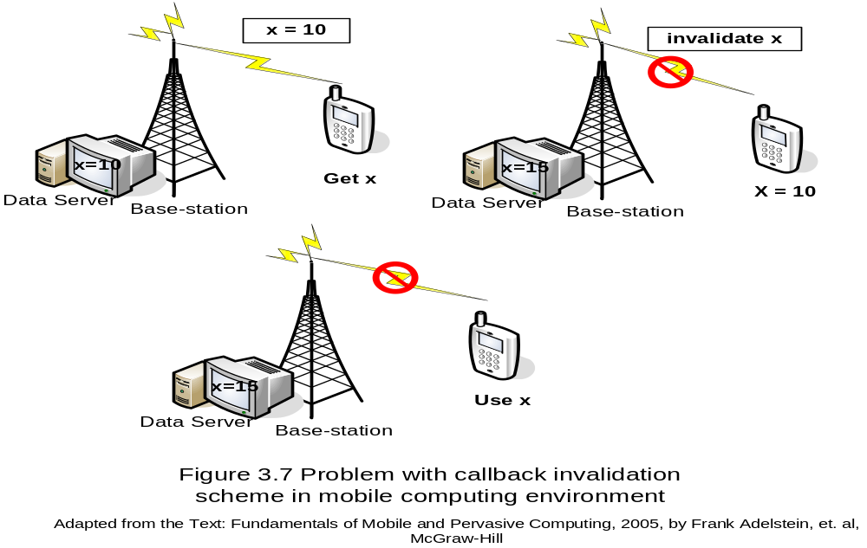
Mobile Cache Maintenance Schemes Broadcasting Timestamp Scheme

Slide 22
Mobile Cache Maintenance Schemes Broadcasting Timestamp Scheme
Data server periodically broadcasting invalidation reports
  All the invalidations in a time window of the last w time units
  Window size w: how long a client can sleep (disconnected from the network)
An invalidation notification from the server: (id, ts)
  id: identifier of a data item
  ts: timestamp denoting the time when data item was modified, i.e.
  t: the time when the invalidation report was sent by the server
  t – w ≤ ts ≤ t

Slide 23
Mobile Cache Maintenance Schemes Broadcasting Timestamp Scheme
A Mobile Client m
  Received an Invalidation Report with timestamp t: IR(t); within w time units from last invalidation report
  Performs (For each data item id in m’s cache)
    Find each data item id in m’s cache with (id, ts) found in report IR(t)
    If timestamp < ts, stale the cache entry for id, and delete the data item
    Otherwise set the timestamp = t for the cached entry

Slide 24
Mobile Cache Maintenance Schemes Broadcasting Timestamp Scheme
A Mobile Client m
  Sleeping window size w time units (disconnected from the network)
  Sleeping longer than w time units
    On receipt of an IR
    Discard all the items in its cache (or revalidate before use)
    Validates the cache entry

Slide 25
Mobile Cache Maintenance Schemes Broadcasting Invalidation Reports
Cache Consistency Management Schemes based on Broadcasting Invalidation Reports
  Broadcasting Timestamp (BT) Scheme – Fig 3.7
  A Variant of Broadcasting Invalidation Report (Jing and Colleagues, 1997) - Adjust the size of the invalidation report to minimize the use of wireless bandwidth while retaining the effectiveness of cache validation
  Two-Level Caching Scheme based on mobility agents that takes into account the Mobility Pattern (Liu and Maguire, 1996)
  Broadcasting Invalidation Report methods take into account the update and query rate/patterns and client disconnection time to optimize query cost (Hue and Lee 1998)

Slide 26
Mobile Cache Maintenance Schemes
Broadcasting Invalidation Reports
Other Cache Consistency Management Schemes based on Broadcasting Invalidation Reports
  Common Characteristics
    Stateless server, and neglect the issue of mobility
    The entire cache is invalid if the client is disconnected for a period longer than the period of the broadcast

Slide 27
Mobile Cache Maintenance Schemes
Disconnection Operation
Some information is better than no information
Disconnection Operation
  Is permitted if data availability is more important than data consistency
  Should not be permitted If obtaining current data is more important
Trade-off
  Availability
  Consistency

Slide 28
Mobile Cache Maintenance Schemes
Disconnection Operation – Coda System
CODA
  A distributed file system, assumes a stateful server
  Support disconnected operations on shared files in UNIX-like environments
Coda Clients
  Hoarding files (a cache maintenance scheme)
  What data items (files) do we hoard?
    use Prioritized Scheme with user assigned priorities on data items
  When and how often do we perform hoarding?
  How do we deal with cache misses?
  How do we reconcile the caches version of the data items with the version at the server?

Slide 29
Mobile Cache Maintenance Schemes
Disconnection Operation – Coda System
What data items (files) do we hoard?
  A prioritized scheme with user assigned priorities on data items
When and how often do we perform hoarding?
How do we deal with cache misses?
How do we reconcile the caches version of the data items with the version at the server?
  Periodical “Hoard Walk” is performed on the cache
  Ensure that no un-cached objects has a higher priority than any cached objects

Slide 30
Mobile Cache Maintenance Schemes
Asynchronous Stateful (AS) Scheme
AS Scheme ensures that the data returned to a mobile client is at most t seconds old, where t is the max latency of forwarding an I.R. from the server to the client via its HA
Designed for applications that require strict data currency guarantees and in which access to stale data is undesirable
Such applications include access to critical data such as Bank Account info, and Air Traffic Info

Slide 31
Mobile Cache Maintenance Schemes
Asynchronous Stateful (AS) Scheme
Use
  Cache consistency maintenance through Asynchronous invalidation reports (call backs)
Send
  Invalidation reports to mobile client (MH) only when some data changes
Home Agent
  Keep track of what data have been locally cached at its mobile hosts (cache state info of the mobile host)
  A HA can be maintained at any trusted static host
  Pass all messages between the Mobile Host and Data server
  To assist with handling disconnections

Slide 32
Mobile Cache Maintenance Schemes
Asynchronous Stateful (AS) Scheme
Home Location Cache
  HLC can be viewed as a Proxy
  Hold a list of records for Mobile Hosts
    (x, T, Invalid Tag)
    x – Identifier of a data item
    T – Timestamp of the last invalidation of x
    Invalid Tag – TRUE (invalidation has been sent to the host, but no ACK yet)

Slide 33
Mobile Cache Maintenance Schemes
Asynchronous Stateful (AS) Scheme
Assume the following Computing (Operation) Scenario
  The application program runs on the client and communicates with the data server through messages
  Client Request Data Item
    Client → Uplink Request (Query) → Data Server
    Client saves some data in its local memory to minimize the number of data request
  Data Server Replying
    Data Server → Downlink Reply (data) → Client

Slide 34
Mobile Cache Maintenance Schemes
Asynchronous Stateful (AS) Scheme
Assumptions
  No message is lost due to communication failure or otherwise in the wired network
  Data server update any data items → Send an Invalidation Message → all Home Agents via the wired network
  Home Agents forwards Invalidation Message to the relevant Mobile Host
  Mobile Host
    Can detect if connected to the network or not
    Receives the Invalidation Message (through roaming and is not disconnected)
    Informs HA before it stores (or updates) any data item in its local cache

Slide 35
Mobile Cache Maintenance Schemes
Asynchronous Stateful (AS) Scheme
A Mobile Host (MH) operates in two modes
  In the Sleep Mode
    Unable to receive any invalidation messages
    Suspends processing of any queries from the applications
    Each Mobile Host maintains a Cache timestamp for holding the timestamp of the last message received from its Home Agent
    The HA uses the cache timestamp to discard invalidations that is no longer needs

Slide 36
Mobile Cache Maintenance Schemes
Asynchronous Stateful (AS) Scheme
A Mobile Host (MH) operates in two modes
  Wake up after a Sleep
    Send a probe message to its HA with its cache timestamp
    The probe message is piggy backed on the 1st query after the wakeup to avoid unnecessary probing
  HA response to the probe message (invalidation check)
    Sends an invalidation report
  MH determines which data items changed while disconnected
  Defers answering all queries that it received, until it has received all the invalidation report from its HA

Slide 37
Mobile Cache Maintenance Schemes
Asynchronous Stateful (AS) Scheme
A Example Scenario (Figure 3.9)
Cache Timestamp t0
  Two data items: IDs x and z
Timestamp t1
  The HLC received an I. Message noting that data item x changed at the server at time t1
  Forward invalidation (x; t1) to HLC and MH
  MH updates its cache timestamp to t1, and delete x from the cache
  MH wants to access y by sending a data request (y;t1) to the HLC
  HLC responds, fetches y, and send it (y; t2)

Slide 38
Mobile Cache Maintenance Schemes
Asynchronous Stateful (AS) Scheme
Timestamp t2
  MH updates its timestamp to t2, adds y to the cache
Timestamp t3
  MH get disconnected – sleep mode
  y changed, and Invalidation message for y is lost
Timestamp t4
  Wakeup
  Z changed, and invalidation message for z is sent
  Ignore all invalidation messages until the 1st query
  Query + Probe (*, t2)
Timestamp t5
  Invalidate message (y,x,t5)

Slide 39
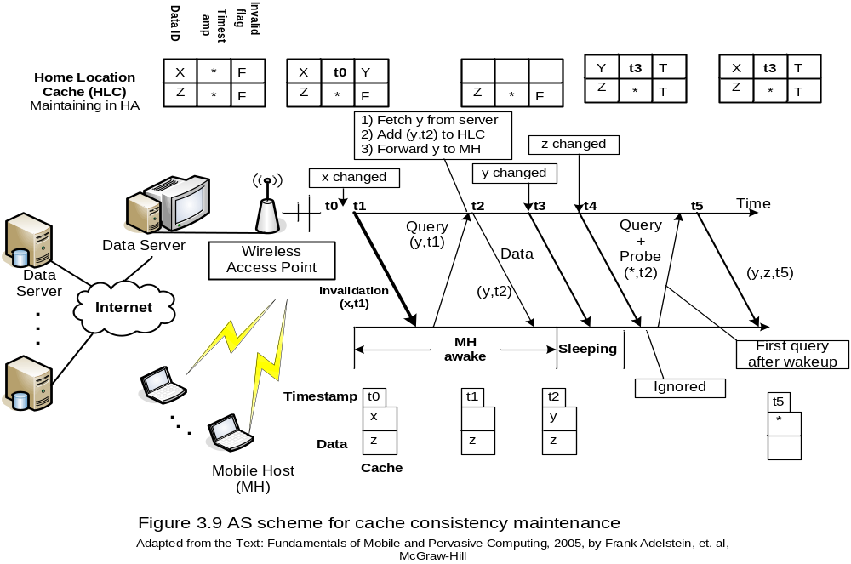
Mobile Cache Maintenance Schemes
Asynchronous Stateful (AS) Scheme

Slide 40
Mobile Cache Maintenance Schemes
To Cache Or Not
If x is never modified – cache a copy at MH m
If x is modifiable? Decision to cache x?
  SA Always
  SA Never
Online Algorithms (Dynamic Optimization)

Slide 41
Mobile Cache Maintenance Schemes
To Cache Or Not
Sliding-Window Dynamic Data Allocation Scheme (Sistla, Wolfson, and Huang – 1998): determine when to cache a data item a mobile client
  Choose AS Always or SA Never based on the recent access pattern history
  The history is maintained as a window of size k, and relevant access operations
    Read operation at the mobile node (rm)
    Write operation at the server (ws)
  The irrelevant operations
    Write operation at the mobile node (wm)
    Read operation at the server (rs)

Slide 42
Mobile Cache Maintenance Schemes
Sliding-Window Dynamic Data Allocation Scheme
A Schedule ψ is a sequence of relevant operations
  Ψ = (ws, rm, rm, ws)
  Two write by the Server
  Two read by the mobile node
Cost(Ψ, SA-always) = 1+0+0+1=2;
Cost(Ψ, SA-never) = 0+1+1+0=2;
Dynamic allocation
  E.g., data allocated at the mobile station after 1st ws and deallocated after the 2nd rm, cost = 0

